Slide 1
N(T)-Level Computer Applications (CPA)
O-Level Computing
H2 Computing
For Candidate's Information
Last Updated: Aug 2025

Slide 2
Context
This guide is to help candidates understand how to use SEAB eExam2 System for CPA / Computing Subject Papers

Slide 3
Index
a. Candidate’s Login
Exam Centre Key
Exam Instructions and Exam Resources Download Page for Candidates
b. Start Exam
Candidate Working File Folders – ResourceFiles and OutputFiles
Candidate Submission
File Submission Error Messages
  File Extension not permitted
  File Size Limit Exceeded
  3rd party application software not closed

Slide 4
Candidate’s Login &
Download of Exam Resources

Slide 5

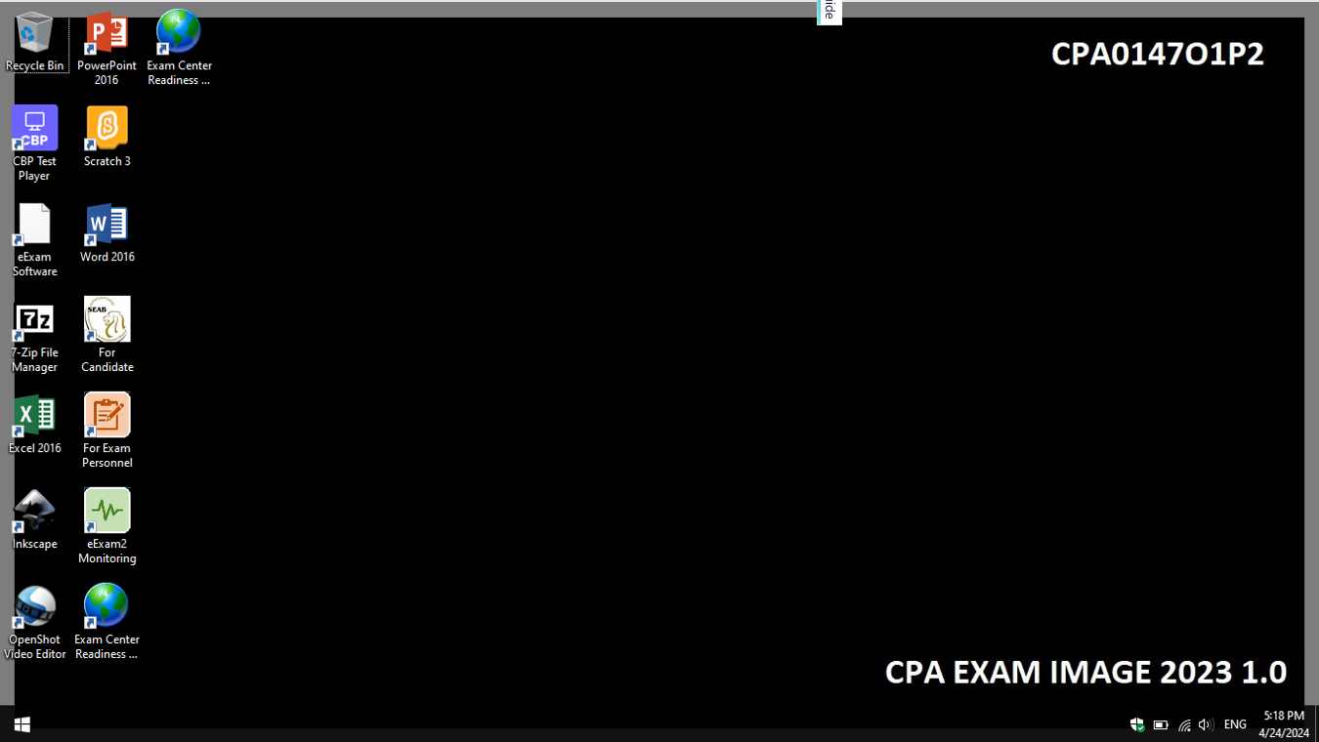
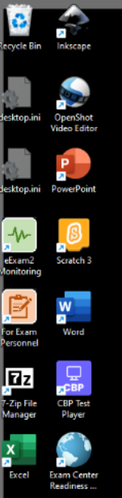



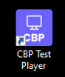
Candidate Login for Computer Based Practical (CBP) e-Exams
Note: This is a sample Windows Desktop for CPA
CPAXXXX
CPA COMBINED EXAM IMAGE XXXX 1.0
Double-click on CBP Test Player icon on the desktop to launch the eExam2 CBP Test Player.

Slide 6
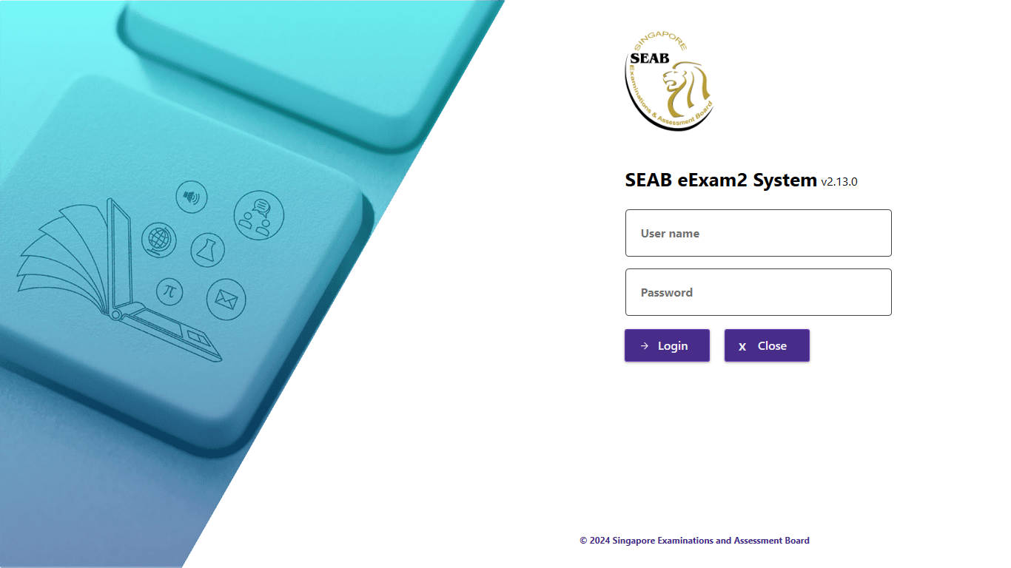

Candidate Login for Computer Based Practical (CBP) e-Exams
v3.6.0
To log in, enter your Username and Password and click Login.
Note: Your credentials will be informed to you only when you are at the exam centre

Slide 7
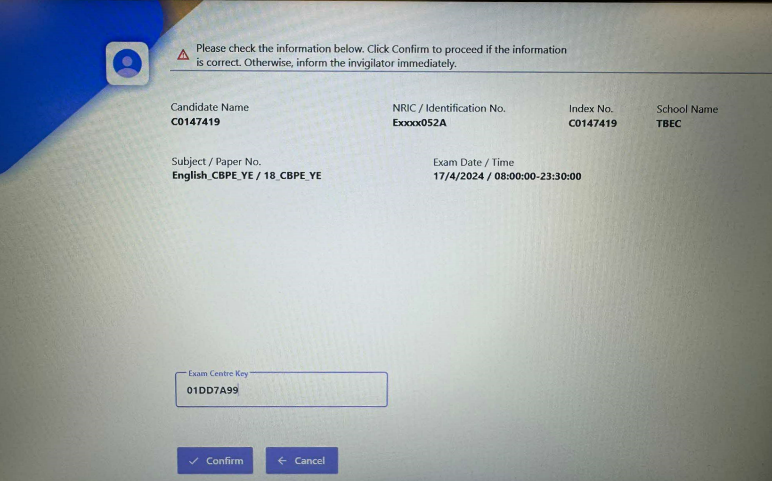
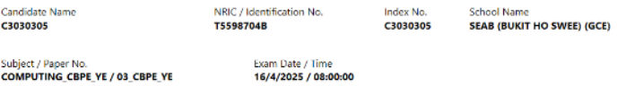

Candidate Information
1. Check the information (particulars & subject paper).
2. Key in Exam Centre Key
(Key in the actual Exam Centre Key provided by the invigilator – written / displayed on whiteboard / screen).
Note: Exam Centre Key is provided to you by the invigilator 5 mins before start of the exam.
3. Click Confirm.
If the details are incorrect, please alert the invigilator immediately.
You can only start the exam (Click Confirm) exactly at the scheduled start time.

Slide 8
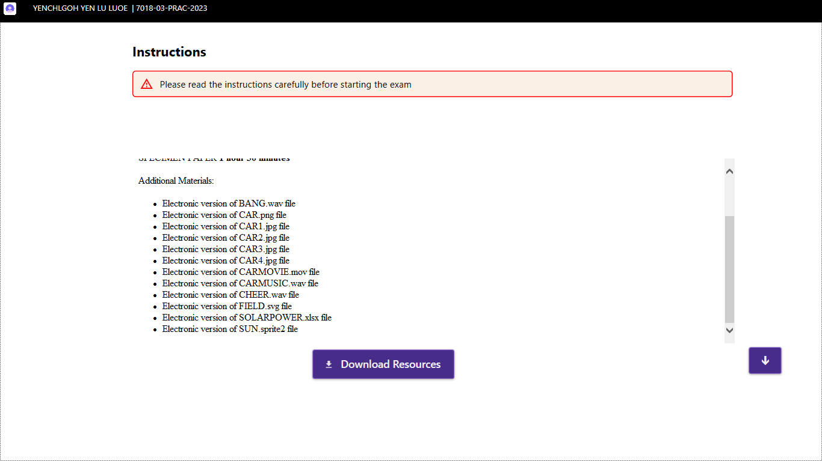
Exam Instructions & Exam Resources Download
At the scheduled time of exam, the Instructions page will be displayed. Please read the instructions carefully.
Click Download Resources once you are ready.
Note: The exam countdown timer has NOT started at this point.

Slide 9
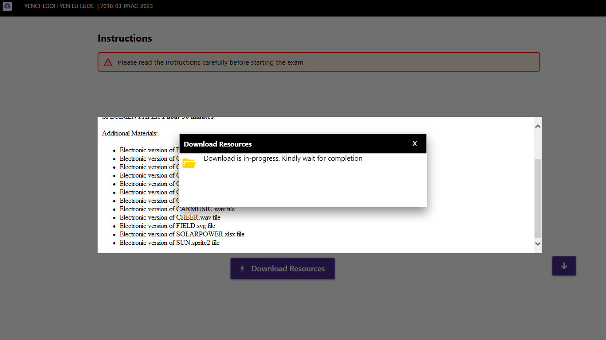
Download Resources
Wait for the Download Resources to be completed

Slide 10
Start Exam

Slide 11
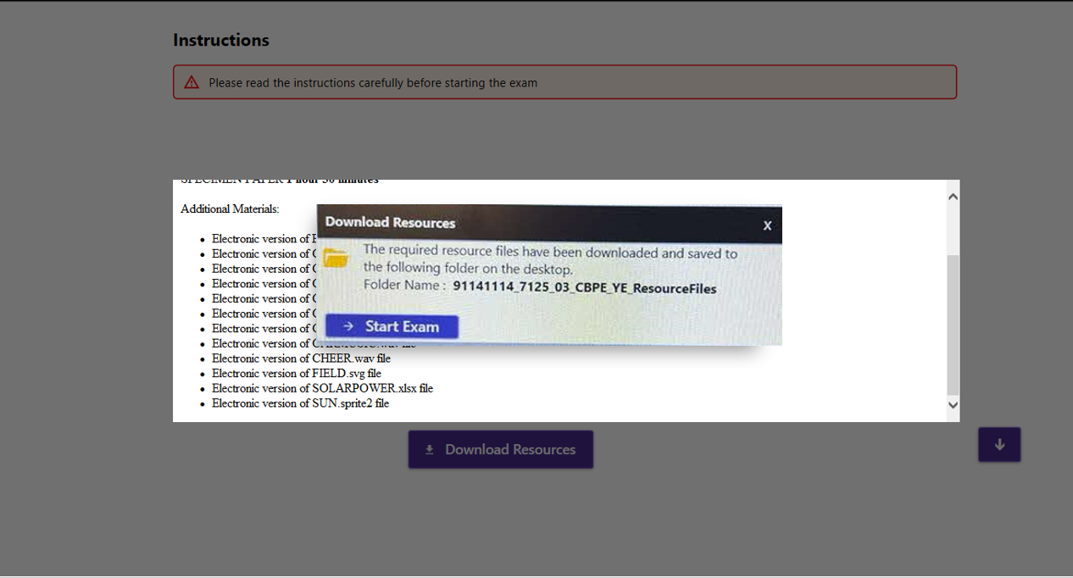
Starting Exam
The resource files for the exam are downloaded to a folder on the desktop named ResourceFiles (folder name is prefixed with your centre index number, subject and paper number as shown above).
Click Start Exam once ready.
Note: The exam countdown timer will start only after you click on the Start Exam button.

Slide 12
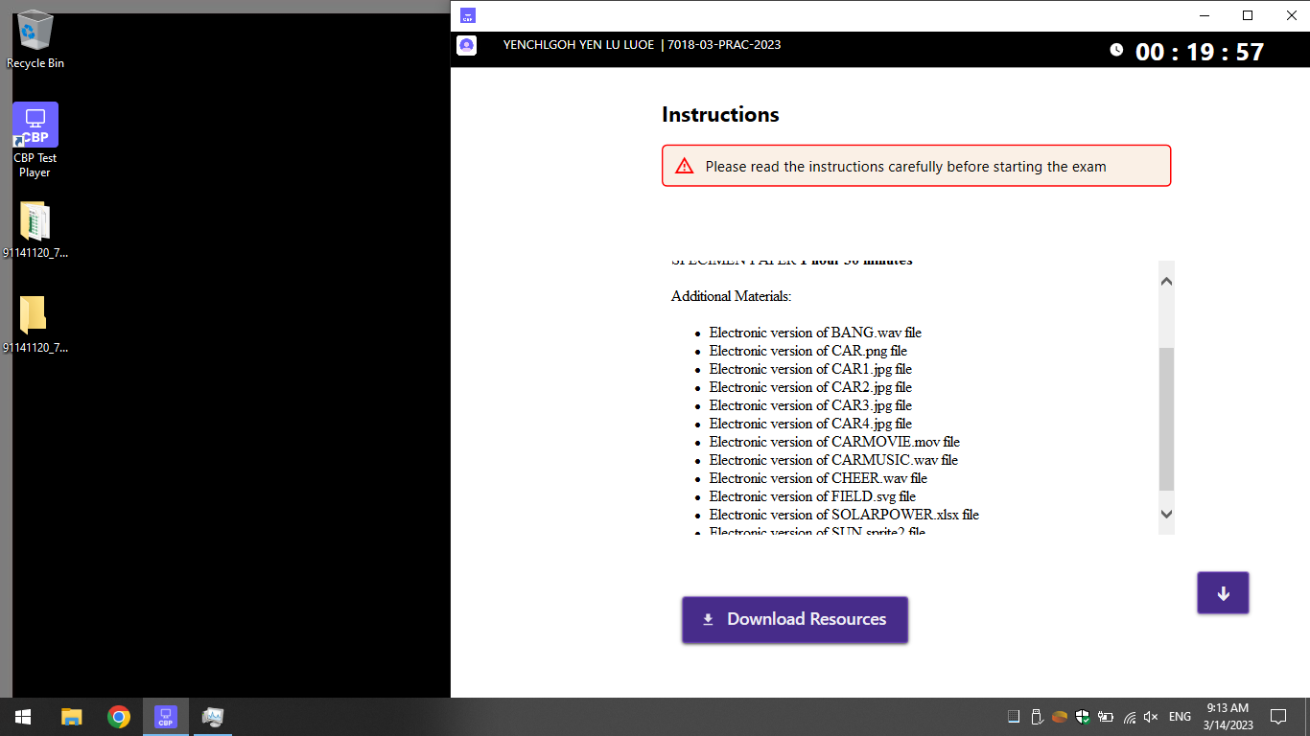



Hardcopy question paper is provided only and not available in the system.
Please note:
Countdown timer is as shown at the top right-hand corner of the screen and cannot be hidden. However, you may minimise the window.
2 folders - ResourceFiles and OutputFiles will be created on the desktop (see illustration below)
1. The exam resource files are downloaded to a folder on the desktop named ResourceFiles.
Countdown Timer
Note: The timer cannot be hidden.
91141120_7018_11_CBPE_YE_ResourceFiles
91141120_7018_11_CBPE_YE_OutputFiles
2. A folder named OutputFiles is created on the desktop for you to save and store your responses i.e. files for submission.
Note: Files placed on the Desktop will not be submitted.

Slide 13
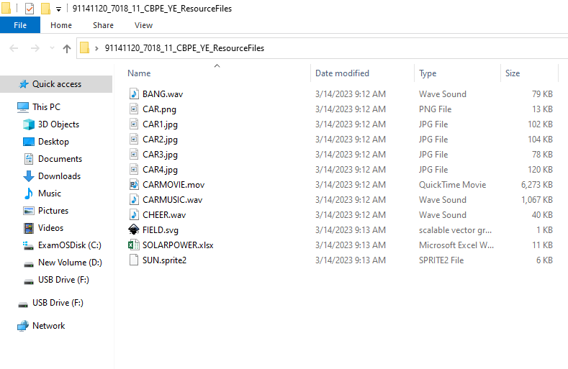
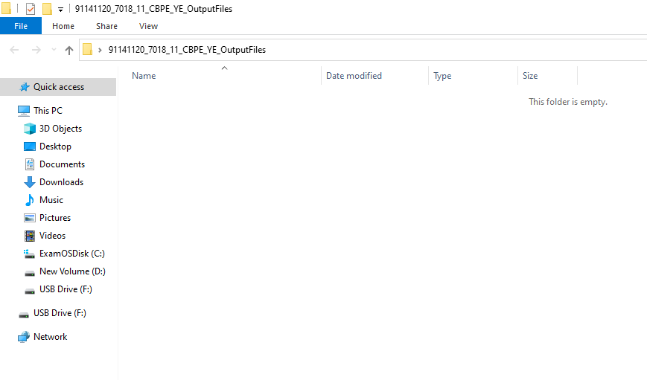
Example of the ResourceFiles folder
Folder name is prefixed with the candidate’s centre index number, subject paper code and paper number + “ResourceFiles”
This ResourceFiles folder is Read-only (you cannot save any file here)
Example of the OutputFiles folder
Folder name is prefixed with the candidate’s centre index number, subject paper code and paper number + “OutputFiles” (you save your files in this folder)

Slide 14
Note:
You can minimise or maximise the screen using “-” and “ ” respectively.
The application is configured to be UNABLE to close during exam time.

Slide 15
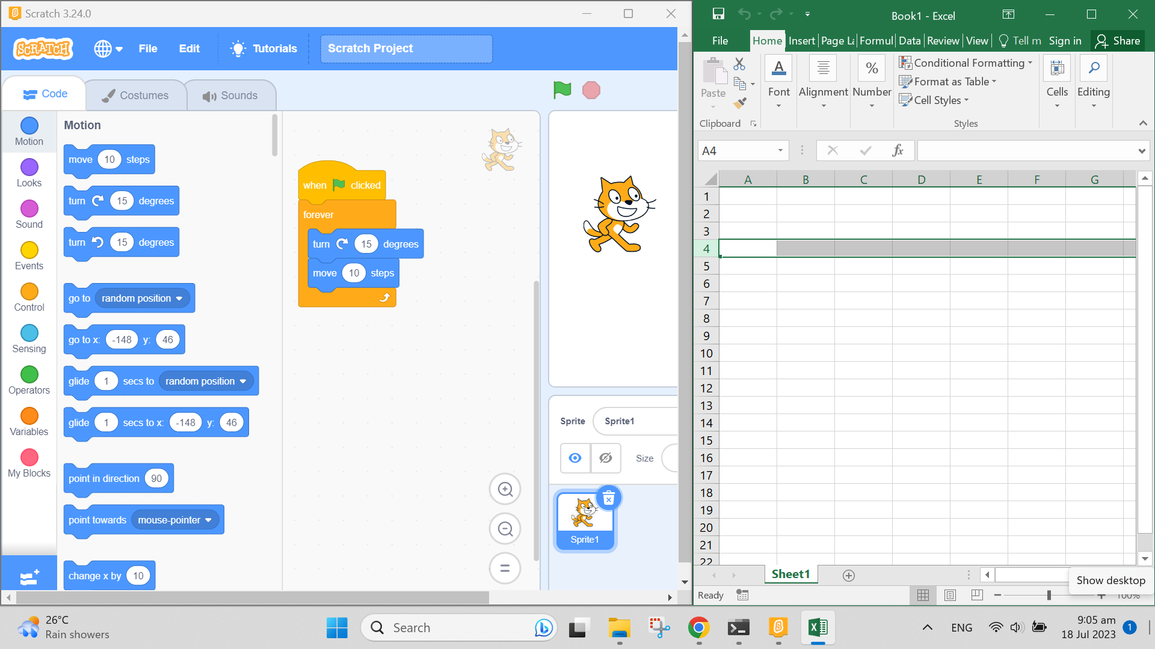
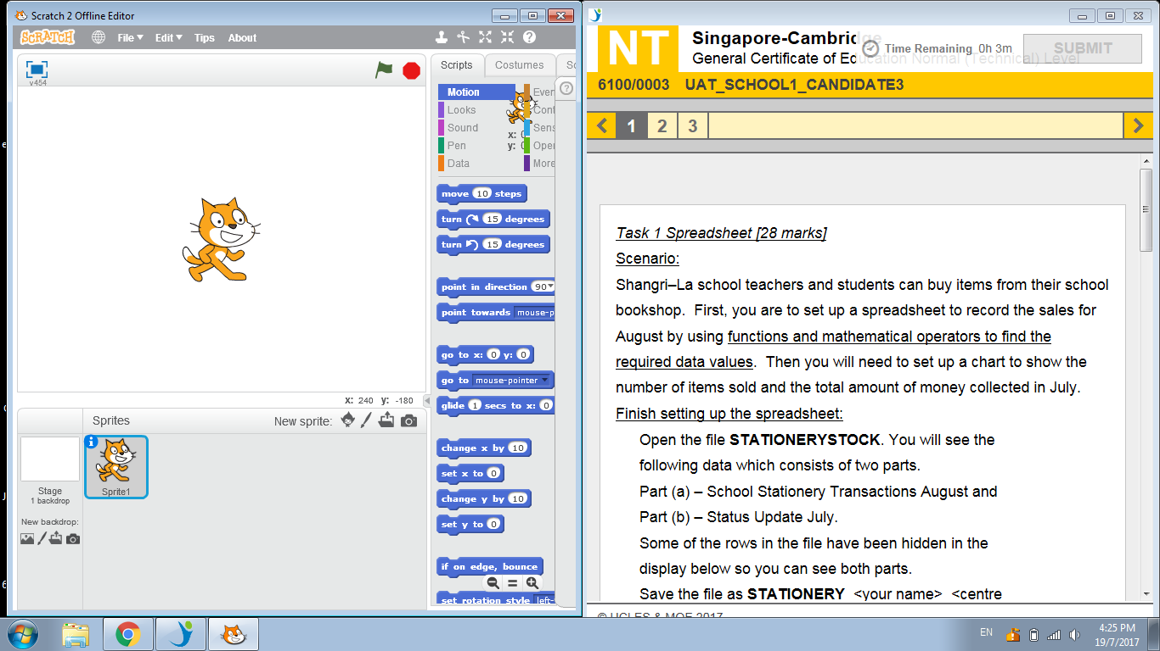
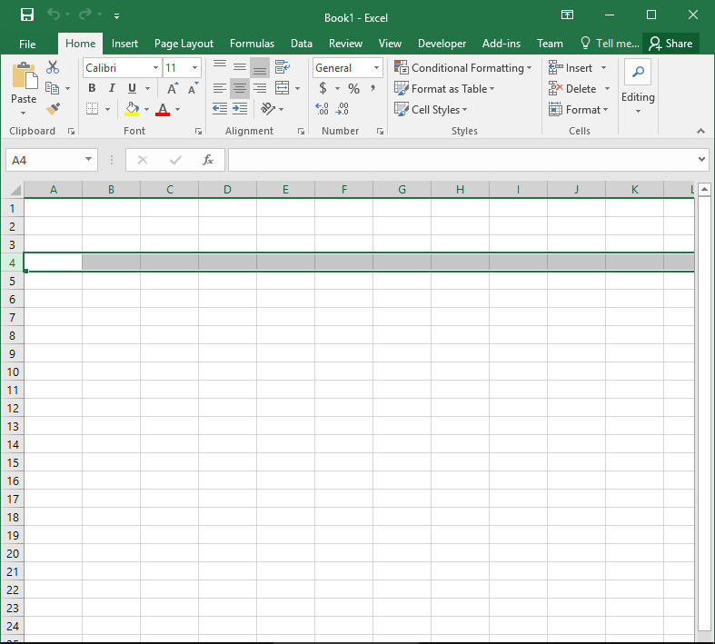
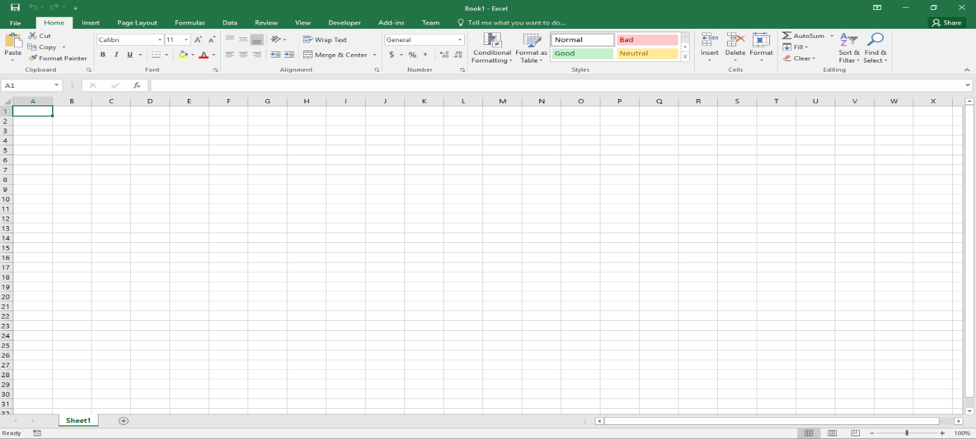
Candidate's Working Files
After the exam resources have been downloaded, candidates can start working with the resource files provided using the approved application software from the desktop (e.g. Scratch for CPA, Python for Computing) in full-screen mode or multiple windows.
Candidate must save their responses (i.e. files) regularly to the OutputFiles folder.
Note: Your responses are NOT auto-saved/ saved by eExam2 system.
For this examination, you may refer to the printed or the electronic question paper provided. The electronic question paper is available in the resource file folder.
For this examination, you may refer to the printed or the electronic question paper provided. The electronic question paper is available in the resource file folder.
Examples of application software - Scratch and Excel

Slide 16
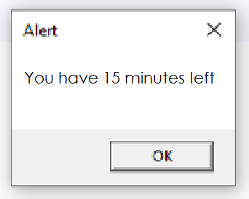
Candidate's Working Files
Reminder: Candidate must save their work regularly.
Important Note: The eExam2 CBP application has no control over other application software:
Candidates’ work in the 3rd party applications are not saved automatically by the eExam2 System (candidates must save their work regularly when using the 3rd party applications).
When time allocated in the eExam2 CBP application has ended, candidates must stop working.
Note: When minimised during the exam, the eExam2 CBP Test Player icon will be displayed at the taskbar.
There will be a pop-up alert box 15 minutes before the end of exam.

Slide 17
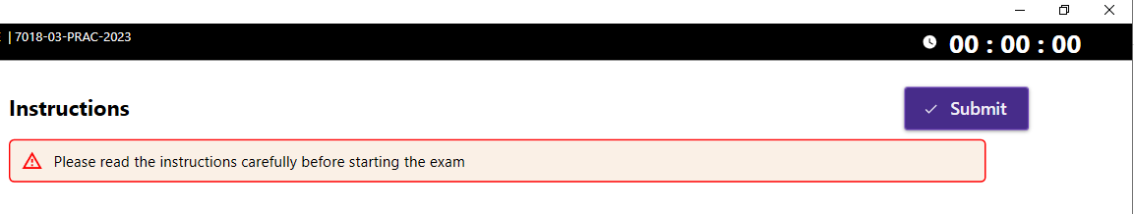
Candidate Submission
Candidates can upload and submit their saved files in the OutputFiles folder only when the time allocated for the exam has elapsed.
When the time is up, the Submit button will be enabled (see below).
Candidates are to click on Submit to check and then upload their files that are saved in the OutputFiles folder.
You are to click Submit when the time is up.

Slide 18
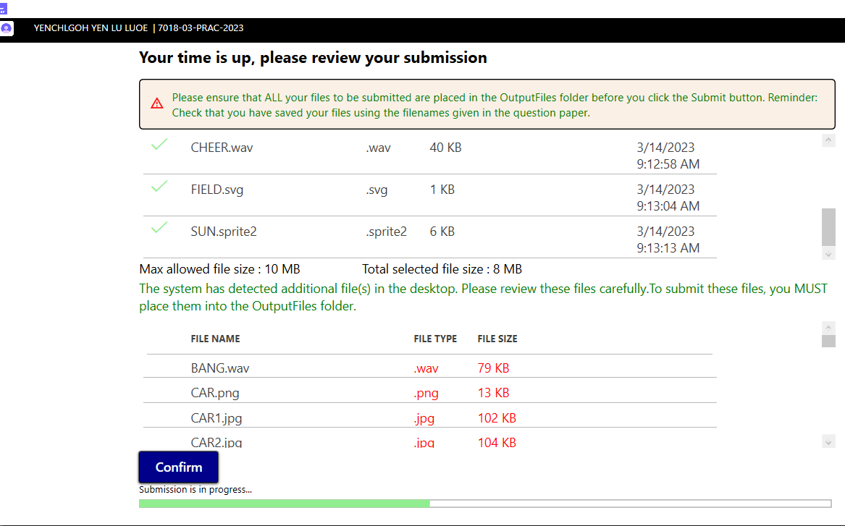

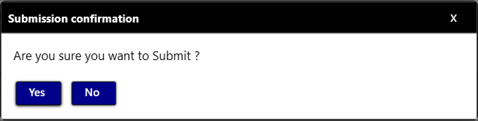
Candidate's Submission - Files are in order and ready to submit
When Submit is clicked, the system will display the files in the OutputFiles folder on the screen (see below).
Candidates must check that all required answer files to be uploaded are saved in the OutputFiles folder.
Files which are not saved in the OutputFiles folder (including the Desktop) will not be uploaded for submission.
1. Candidate files saved in the OutputFiles folder are listed here.
Please ensure that all required files are shown.
2. These files are found outside the OutputFiles folder. Candidates must check if these files should be submitted. If so, minimise the submission window and move the file(s) to the OutputFiles folder.
3. Click Confirm only when all the files to be submitted are in the OutputFiles folder.
4. Click Yes to confirm. The Submission progress bar will appear. Please wait for the submission to be completed.

Slide 19
File Submission Error Messages

Slide 20
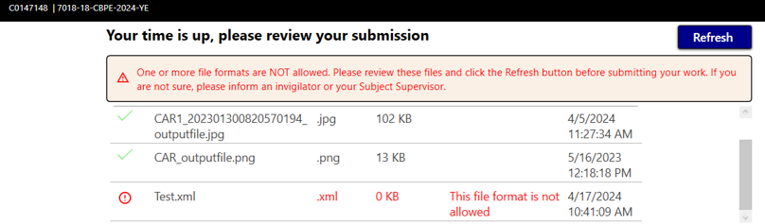
Error: File extension not permitted
If there are any files with invalid formats, the following message will be displayed.
Candidates must make the necessary changes before they can submit their work.
The system will detect if the file is not in the recommended list of file format to be submitted. Alert invigilator / SS for assistance in this case.

Slide 21
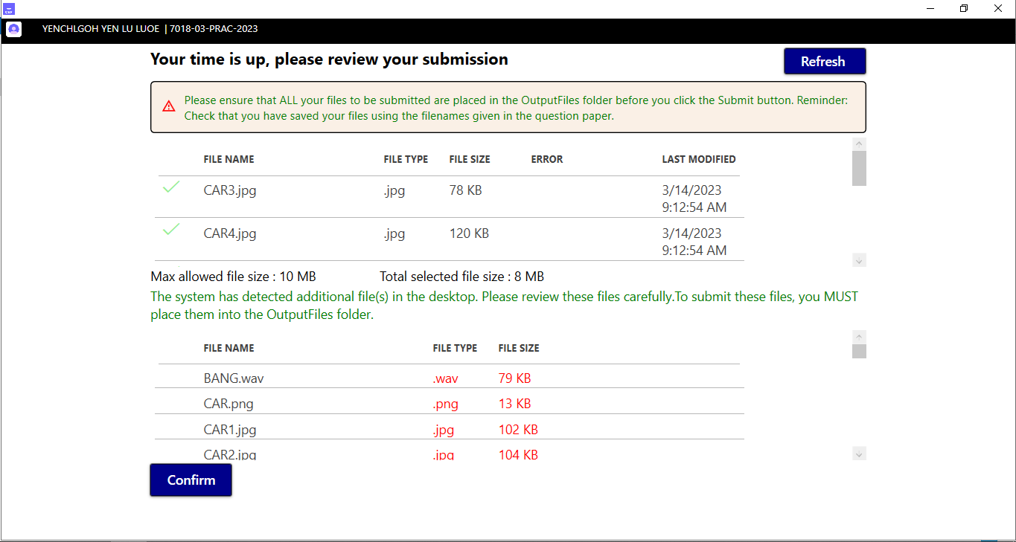
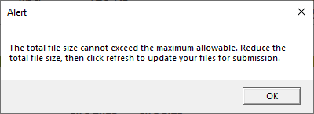
Error: File Size limit exceeded
If the total file size of the files in the OutputFiles folder exceeds the maximum allowed for submission, the system will prompt you with an error message to reduce the total file size. Candidates must make the necessary changes before they can submit their work.
Please note:
Candidate must ensure the files are saved in the format stated in the Question Paper.
Remove all unnecessary files from the OutputFiles folder.
13 MB

Slide 22
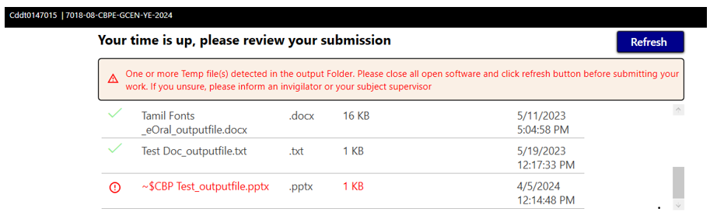
Error: 3rd party application software not closed
Reminder: To ensure all files submitted are complete, Candidate must close all 3rd party application software.
Important Note:
Any 3rd party application software not closed will cause the file to be locked and temporary file(s) to be created. If 3rd party application software are not closed, the following message will be displayed.
The 3rd party application software will create a temp file if it is not closed. This is not desirable. Hence, please close your application first.

Slide 23
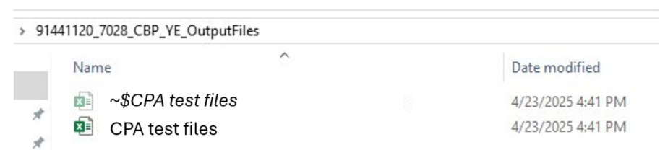
Error: 3rd party application software not closed
Reminder: To ensure all files submitted are complete, Candidate must close all 3rd party application software.
Issues encountered if 3rd party software is not closed during submission
Despite closing all 3rd party application software, some candidates may still encounter issue submitting the files online. If candidate is unable to submit as system still detects temp files, candidate may need to delete the unnecessary temp files in his/her submission folder (OutputFiles folder).​
Remove the temporary file
Note: This temp file is not required by the markers. Hence safe to remove.

Slide 24
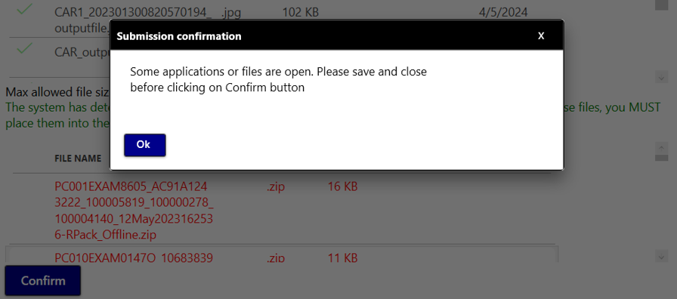
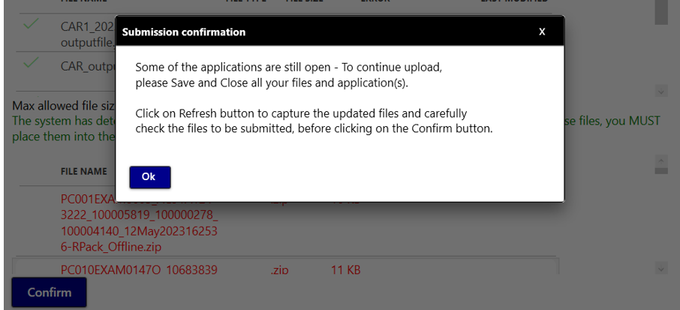
Error: 3rd party application software not closed
Reminder: To ensure all files submitted are completed, Candidate must close all 3rd party application software.
Important Note:
Candidate may receive further alerts if 3rd party application software is still not closed upon clicking Confirm.
1st message prompt to close 3rd party application
Subsequent message prompt to close 3rd party application

Slide 25
Once errors are corrected, click Refresh and Confirm to Submit
Important Note:
Click Refresh once you have managed to resolve the issues pointed out by the error message(s) (e.g. files added/removed, file saved in correct format, application software closed etc.)
Refresh button
Click Refresh to refresh the list of files after removal of invalid files or addition of required files.
Candidate answer files (in the OutputFiles folder) will be displayed here.
Files found on the desktop will be listed here but will not be included for submission.
Confirm button
Will only be enabled when all files are in order.

Slide 26

End of the Exam
When file upload is successful, this screen will be shown.
Click End Exam or this page will automatically close (after 10 seconds) to indicate the end of the exam and return you to the Exam Image desktop

