Slide 1

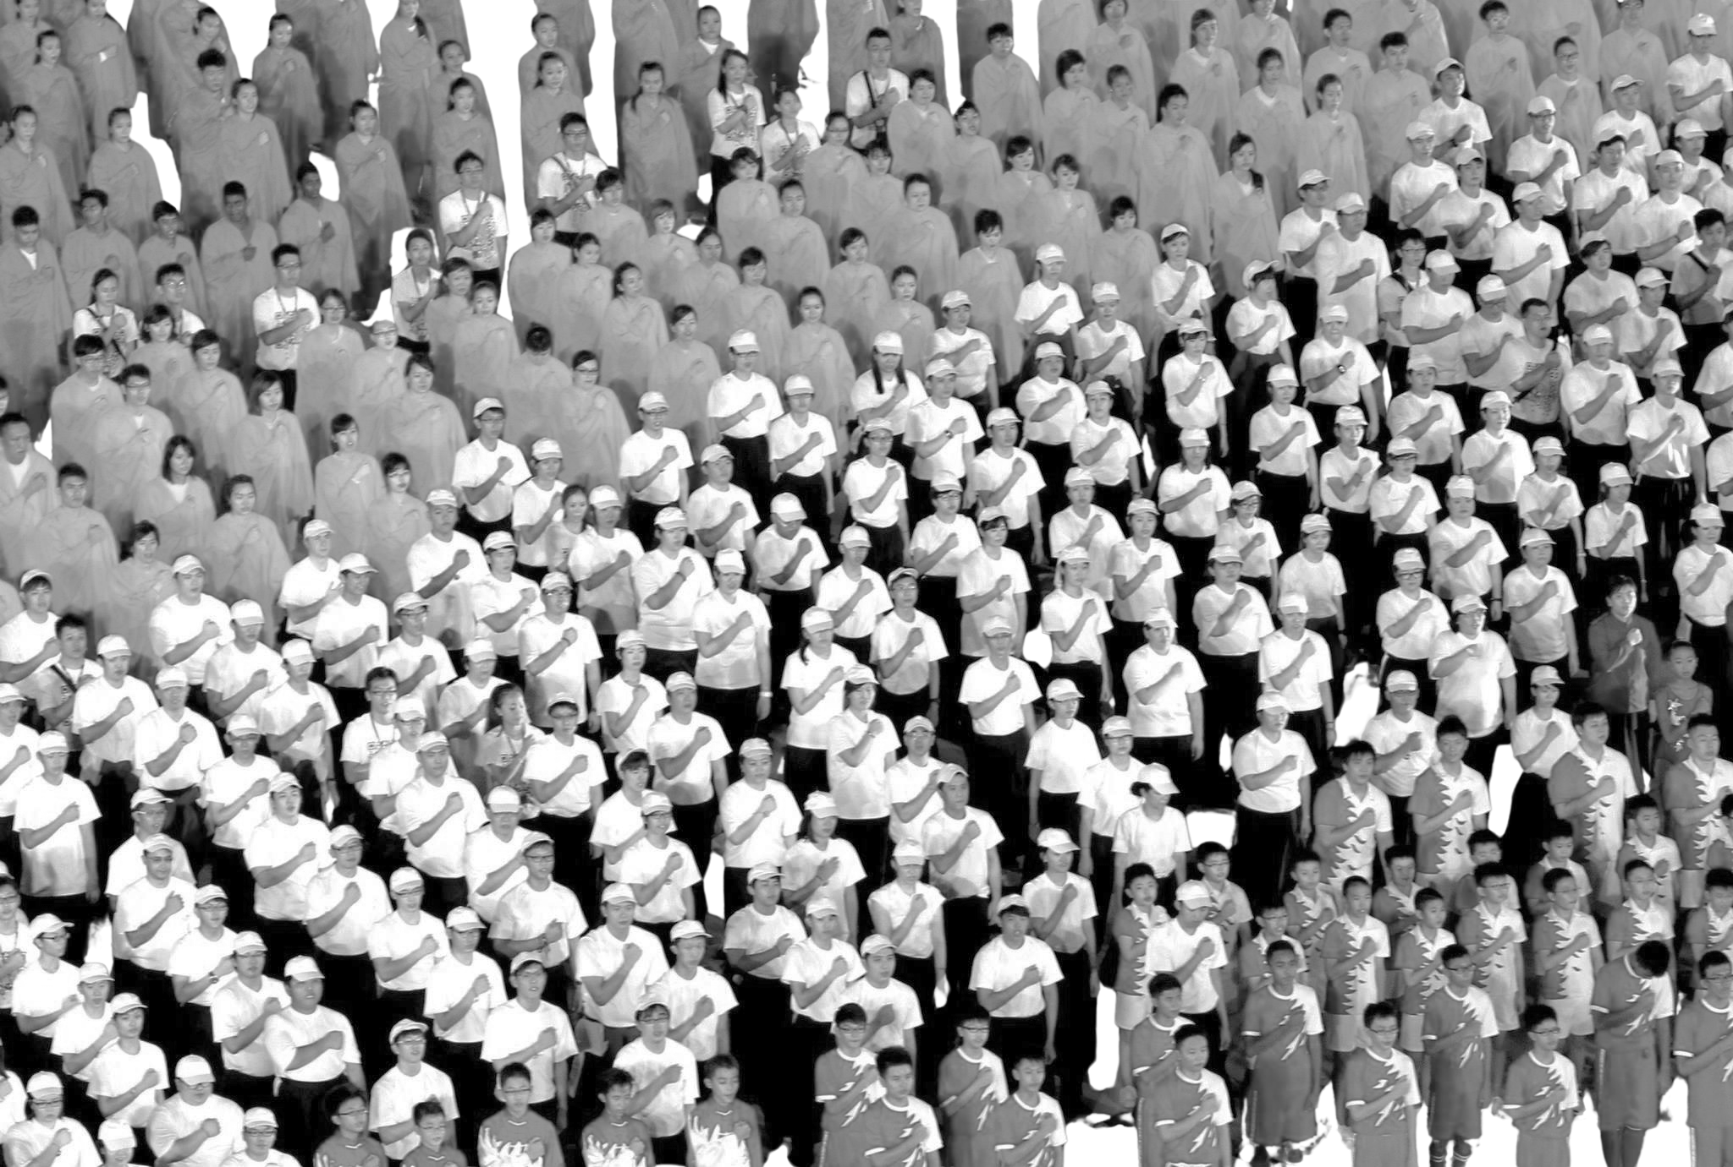

OFFICIAL (OPEN)
WE, THE
CITIZENS
WHAT DOES THE NATIONAL PLEDGE MEAN FOR US TODAY?
Image: Ministry of Digital Development and Information (2013)
OFFICIAL (OPEN)
Notes:
OFFICIAL (OPEN)
OFFICIAL (OPEN)

Slide 2
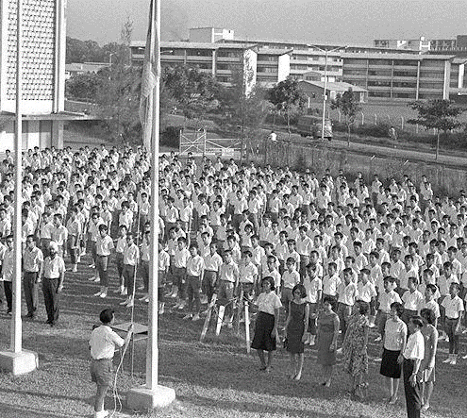
OFFICIAL (OPEN)
2026 marks
60 years
of the Pledge
WE, THE CITIZENS OF SINGAPORE,
PLEDGE OURSELVES AS ONE UNITED PEOPLE,
REGARDLESS OF RACE, LANGUAGE OR RELIGION,
TO BUILD A DEMOCRATIC SOCIETY
BASED ON JUSTICE AND EQUALITY
SO AS TO ACHIEVE HAPPINESS, PROSPERITY
  AND PROGRESS FOR OUR NATION.
Image: National Archives of Singapore (1966)
2
OFFICIAL (OPEN)
Notes:
As we commemorate the 60th anniversary of the Pledge this year, it is timely to reflect on what these words truly mean for us as Singaporeans, beyond simply reciting them.
Suggested questions to pose to audience:
Which part of the Pledge do you identify with the most, and why?
What’s one recent moment where you saw the values of the Pledge in action in your daily life?
OFFICIAL (OPEN)
OFFICIAL (OPEN)

Slide 3

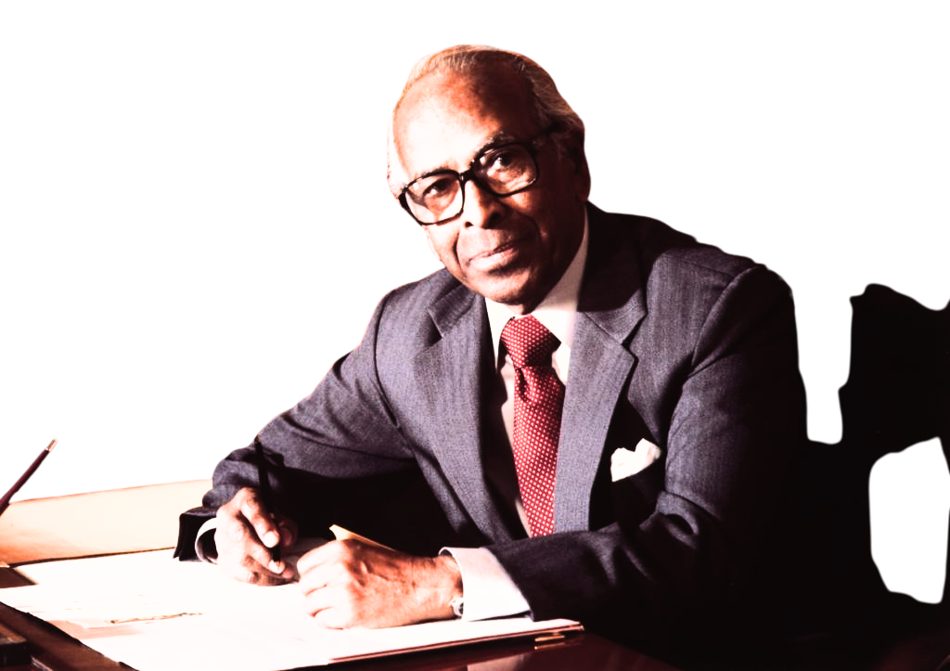

OFFICIAL (OPEN)
Origins
“
  Being a Singaporean is not a matter of ancestry.
  1950s & 1960s
Communal tensions and
series of racial riots
“
  9 Aug 1965
Singapore gained independence after separation from Malaysia
  IT IS CONVICTION AND CHOICE.
  Oct 1965
  MOE officials mooted the idea of a pledge to inculcate national consciousness among citizens
  - S. Rajaratnam, Singapore’s first Minister for Foreign Affairs
  Feb 1966
  Two drafts of the Pledge by MOE officials were submitted to Mr S. Rajaratnam for comments, and in his reply, he wrote a third draft of the Pledge
  Aug 1966
  The National Pledge was approved by the Cabinet (following another round of revisions by MOE officials)
  24 Aug 1966
  First recitation of the Pledge by 500,000 students
Image: ISEAS Library, ISEAS-Yusof Ishak Institute, Singapore
3
OFFICIAL (OPEN)
Notes:
The Pledge emerged during a difficult and uncertain period in Singapore’s history.
In the years leading up to Singapore’s independence on 9 Aug 1965, we experienced communal tensions and racial riots which caused fear, loss of lives, and divisions within society.
As a young nation made up of people from different races, languages, and religions, Singapore needed to build not just our economy or infrastructure. There was a pressing need to ensure that our people were united, with a shared sense of identity and belonging, so that divisions of the past would not be repeated.
In October 1965, Mr William Cheng, Principal Assistant Secretary of Administration of the Ministry of Education, mooted the idea of a pledge to inculcate national consciousness and patriotism in schools. The idea gained the support of then-Minister for Education, Mr Ong Pang Boon.
Mr Ong then sent the drafts to then-Minister for Foreign Affairs Mr S. Rajaratnam in 1966. Mr Rajaratnam’s re-written draft would form the basis of the Pledge as we know it today. His version expressed the ideals and values that would unite Singaporeans despite their differences. Mr Rajaratnam believed that race, language, and religion were potentially divisive factors. He therefore used the Pledge to emphasise that these differences could be overcome if Singaporeans were united in their commitment to the country.
Reference:
https://www.nhb.gov.sg/what-we-do/our-work/community-engagement/education/resources/national-symbols/national-pledge
OFFICIAL (OPEN)
OFFICIAL (OPEN)

Slide 4
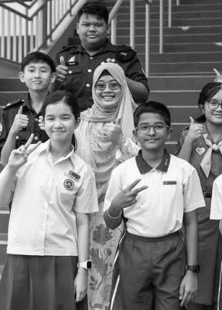
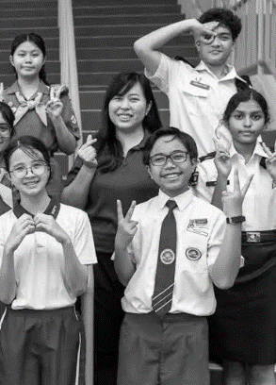
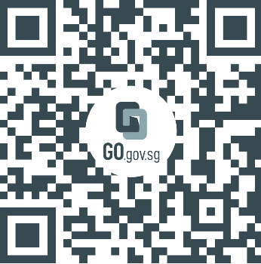
OFFICIAL (OPEN)
Values
  Multiculturalism
Every Singaporean belongs as an equal member of society
regardless of race,
language or religion,
  Democracy
Every citizen has a voice and a stake in shaping Singapore’s future
to build a democratic society…
  Justice
Every individual is treated fairly and with dignity
Image: Ministry of Education
…based on justice…
  Equality
Every Singaporean has a fair opportunity to fulfil their potential, regardless of starting point
  Origins of
  the Pledge:
  An Animation
…and equality…
4
OFFICIAL (OPEN)
Notes:
For six decades, the Pledge has reminded Singaporeans of the values that hold us together as one united people: multiculturalism, democracy, justice, and equality.
Multiculturalism – Multiculturalism means that no single racial, linguistic, or religious group defines Singapore and that every Singaporean belongs as an equal member of society. This belief is reflected in the Pledge, which reminds us that we are one people, “regardless of race, language, or religion”. We view our diversity as a source of strength, not division.
Democracy – Under democracy, every citizen has a voice and stake in shaping Singapore's future. This means voicing our views and ideas responsibly in public discussions, playing an active role in our community, and sharing the responsibility to face challenges and difficult decisions needed to build our nation.
Justice – Justice is the promise that every individual can expect to be treated fairly and with dignity. Rules apply equally to everyone, regardless of status, wealth, or background. This principle has been foundational to Singapore’s development – a society where people trust that the system is fair, that effort is rewarded, and that wrongdoing is addressed without favour. Justice requires our active commitment – to act with integrity in our own dealings, speak up when someone is treated unfairly, and to extend fairness and dignity to those around us, including those with less power or voice.
Equality – Equality is the belief that every Singaporean has a fair opportunity to fulfil their potential, regardless of starting point. While people begin from different circumstances, a just society ensures these differences do not become permanent barriers. This commitment has driven Singapore’s investments in education, housing, healthcare, and social mobility over the decades – creating pathways for Singaporeans from all backgrounds to progress and contribute. Let us support one another so that every Singaporean has a genuine opportunity to thrive, and no one is left behind.
“This is not a Malay nation; this is not a Chinese nation; this is not an Indian nation. Everyone will have his place, equal: language, culture, religion” – Then-Prime Minister Lee Kuan Yew at press conference on 9 Aug 1965 announcing Singapore’s separation from Malaysia
Animation: Origins of the Pledge
Tracing the history of the Pledge, the video highlights its core values and ideals, and encourages viewers to reaffirm their commitment to them. Facilitators may play the accompanying video at the end of this slide to emphasise the importance of the Pledge.
References:
https://www.mccy.gov.sg/about-us/news-and-resources/unity-and--we-first--mindset-key-for-singapore-to-stay-exceptional-in-a-changed-world
https://www.mlaw.gov.sg/files/news/speeches/Transcript_SMS_speech_at_37th_SLR_Annual_Lecture.pdf
OFFICIAL (OPEN)
OFFICIAL (OPEN)

Slide 5
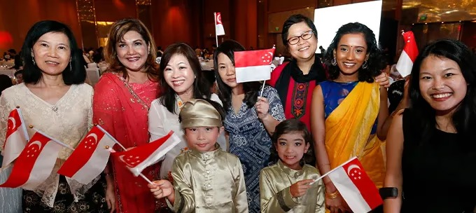
OFFICIAL (OPEN)
ONE
united
PEOPLE
From our earliest years, Singapore made a deliberate choice that diversity would be a source of strength, not division. This conviction has shaped our policies, institutions, and way of life.
Multiculturalism is not a natural state – it is a daily practice. As our society becomes more diverse and as global forces test social cohesion everywhere, sustaining harmony will require us to continually deepen mutual understanding and broaden our common spaces.
Image: Ministry of Culture, Community and Youth
5
OFFICIAL (OPEN)
Notes:
The Pledge opens not with "I", but with "We". Our unity has never meant uniformity. At independence, Singapore made a deliberate choice that our diversity would be a source of strength, not division. This conviction shaped our policies, our institutions, and the way our communities grew up alongside one another – living, working, and learning side by side in shared spaces.
This is why multiculturalism is not a natural state that takes care of itself. It is a daily practice – in the friendships we build across communities, the common spaces we protect, and each community's willingness to compromise for the common good. Every Singaporean is both a beneficiary and a guardian of it.
OFFICIAL (OPEN)
OFFICIAL (OPEN)

Slide 6
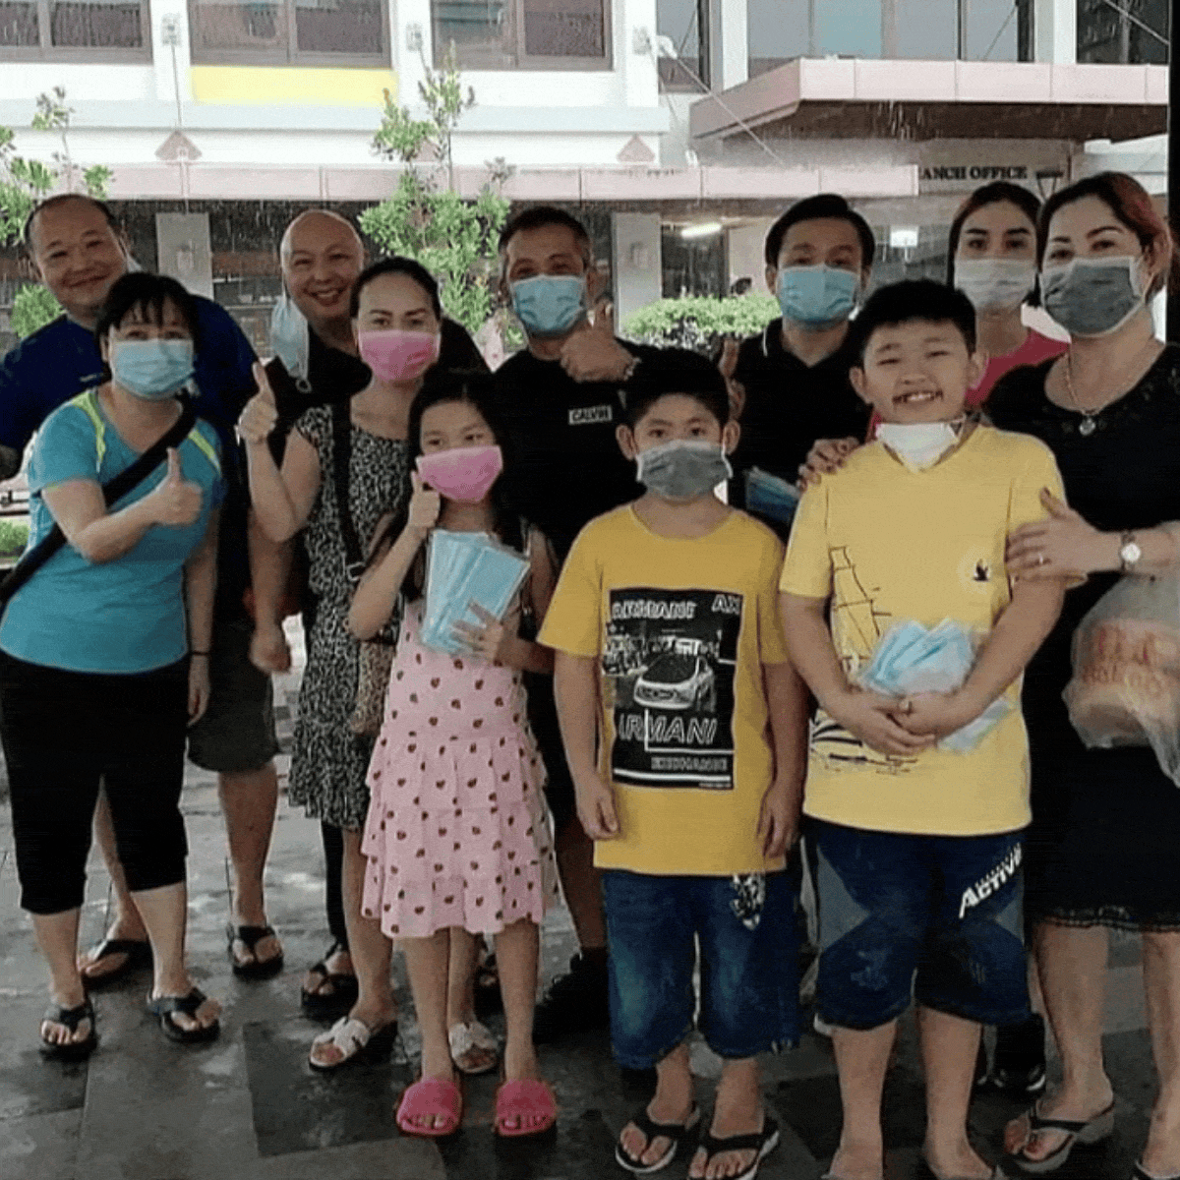
OFFICIAL (OPEN)
2020
We supported one another when COVID-19 shook Singapore
Images: Costa Ris RC, gov.sg, Martin Lim, Singapore Kindness Movement, The Straits Times
6
OFFICIAL (OPEN)
Notes:
The COVID-19 pandemic was one of the most challenging periods for Singapore in recent history. Our daily lives were disrupted, and many difficult decisions had to be made amid uncertainty and rapidly changing circumstances.
Yet even during this period, many Singaporeans stepped forward to support one another. Businesses and communities showed care and solidarity:
A couple used their own money to buy 6,600 masks to distribute to fellow Singaporeans.
In many housing estates, residents placed bottles of hand sanitiser in HDB lifts for their neighbours to use.
Hawker store “Beng Who Cooks” prepared and delivered free meals to those in need.
Some churches and mosques opened up as temporary shelters under the Ministry of Social and Family Development’s Safe Sound Sleeping Places initiative, providing rough sleepers and homeless persons a safe environment to rest overnight.
These acts demonstrated the spirit of unity, looking out for one another, and putting the community first “regardless of race, language, or religion”, echoing the values of our Pledge.
Suggested questions to pose to audience:
What other acts of care/support do you recall during COVID-19 or even in everyday life?
What values of the Pledge do they reflect?
References:
COVID-19 White Paper, https://isomer-user-content.by.gov.sg/34/4aba909a-1b28-40b1-ba93-ebe3528881b1/130323_PMO_LoRes_CovidPaper.pdf
https://www.sg101.gov.sg/society/case-studies/covid19
https://www.facebook.com/gov.sg/videos/278885310013565
https://www.straitstimes.com/singapore/network-helped-rough-sleepers-to-find-shelter-at-onset-of-pandemic
https://www.facebook.com/photo?fbid=408481451314345&set=pcb.408483144647509
OFFICIAL (OPEN)
OFFICIAL (OPEN)

Slide 7
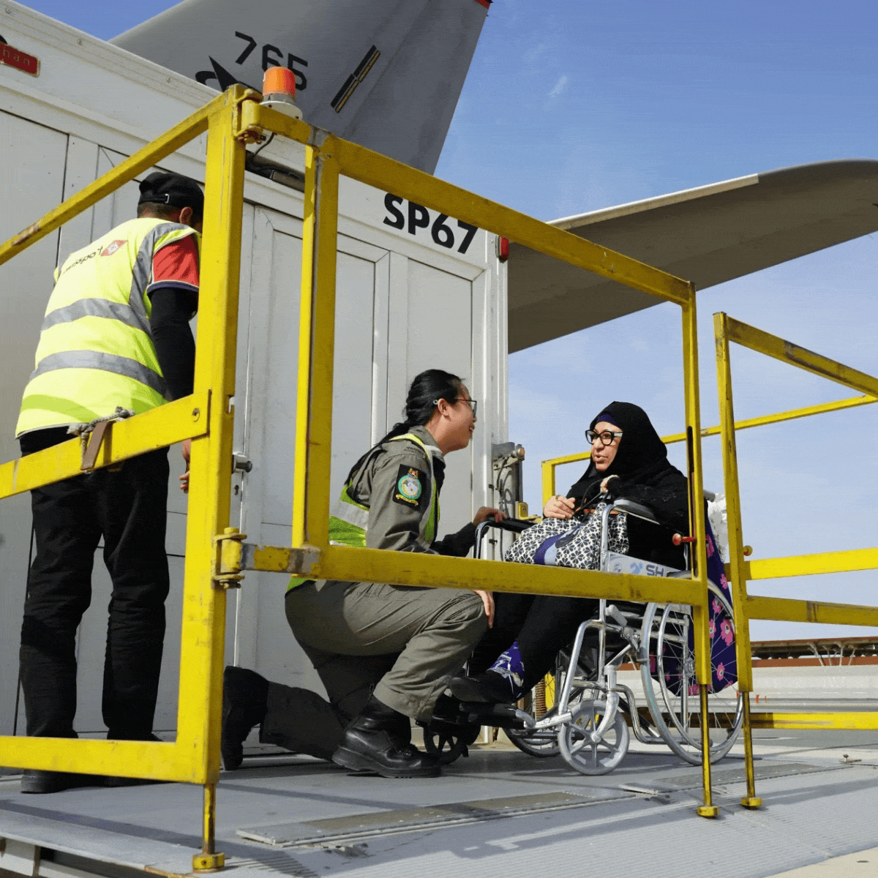
OFFICIAL (OPEN)
2026
We came together to bring Singaporeans home during the Middle East conflict
Images: Ministry of Defence, Ministry of Foreign Affairs, Channel NewsAsia
7
OFFICIAL (OPEN)
Notes:
When the Middle East conflict disrupted air travel in the region, many Singaporeans were left stranded overseas.
Personnel from different agencies, including government ministries, the Singapore Armed Forces, and Singapore Airlines, worked together around the clock, to coordinate evacuation efforts and ensure the safe return of Singaporeans and their families.
This illustrated the strong sense of responsibility, dedication, and commitment across both public and private sectors to go beyond the call of duty in supporting their fellow Singaporeans who needed help in a war-torn zone. It demonstrates how we continue to stand by one another in times of crisis as “one united people”, ”regardless of race, language, or religion”.
These efforts were met with heartfelt appreciation from the wider public, reflecting a shared sense of pride and solidarity among Singaporeans.
References:
https://www.mindef.gov.sg/news-and-events/latest-releases/13mar26-nr
https://www.mindef.gov.sg/news-and-events/latest-releases/7apr26-pq
https://www.straitstimes.com/opinion/forum/forum-what-welcome-home-means-to-a-Singaporean-on-board-an-rsaf-evacuation-flight
OFFICIAL (OPEN)
OFFICIAL (OPEN)

Slide 8
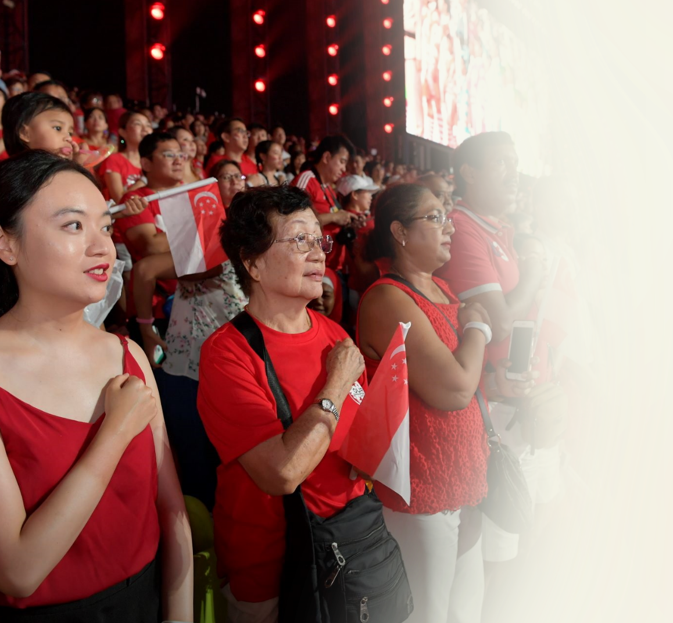
OFFICIAL (OPEN)
“WE , THE CITIZENS”
The Pledge reflects our commitment across generations – to place the collective good above individual interests.
It is not just something we say, but something we choose to live out – through acts of care, respect, and responsibility in everyday life.
“
“
WHEN THE WHOLE IS STRONG,
EACH OF US BECOMES STRONGER TOO.
- Prime Minister Lawrence Wong’s National Day Rally 2025 speech
Image: Ministry of Defence
8
OFFICIAL (OPEN)
Notes:
We have come a long way from the first recitation of the Pledge in 1966.
Today, becoming a “We First” society will embody our continued commitment to the values of the Pledge, as shown in the examples earlier. This means placing the collective good above individual interests, looking out for one another, and building a shared future despite differences in race, language, or religion.
When we recite the Pledge, we are reminded to live out its values in our everyday actions – no matter how big or small.
Suggested questions to pose to audience:
The Pledge was written in a very different time, soon after Singapore’s separation from Malaysia. Is it still relevant today, and why?
What is one thing you can do to practise “We First” in your school, home, or community?
Can you think of a moment where you had to choose between “me” and “we”? What did you learn from it?
Reference:
https://www.pmo.gov.sg/newsroom/ndr: “To keep Singapore going, we must be a “We-First” society. Because if everyone only thinks about “me”, and puts “me” ahead of “we”, then we are finished. Society will fray, and things will fall apart. But if each of us does our part for the “we” – care, contribute, and look out for one another – then the “me” will thrive and flourish too. Because when the whole is strong, each of us becomes stronger too.“ – Prime Minister Lawrence Wong, National Day Rally 2025
OFFICIAL (OPEN)
OFFICIAL (OPEN)

Slide 9
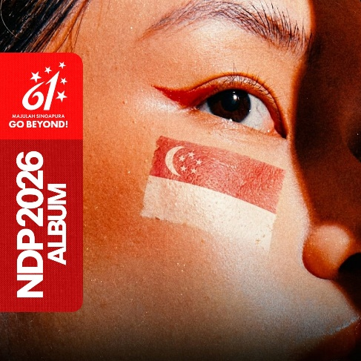
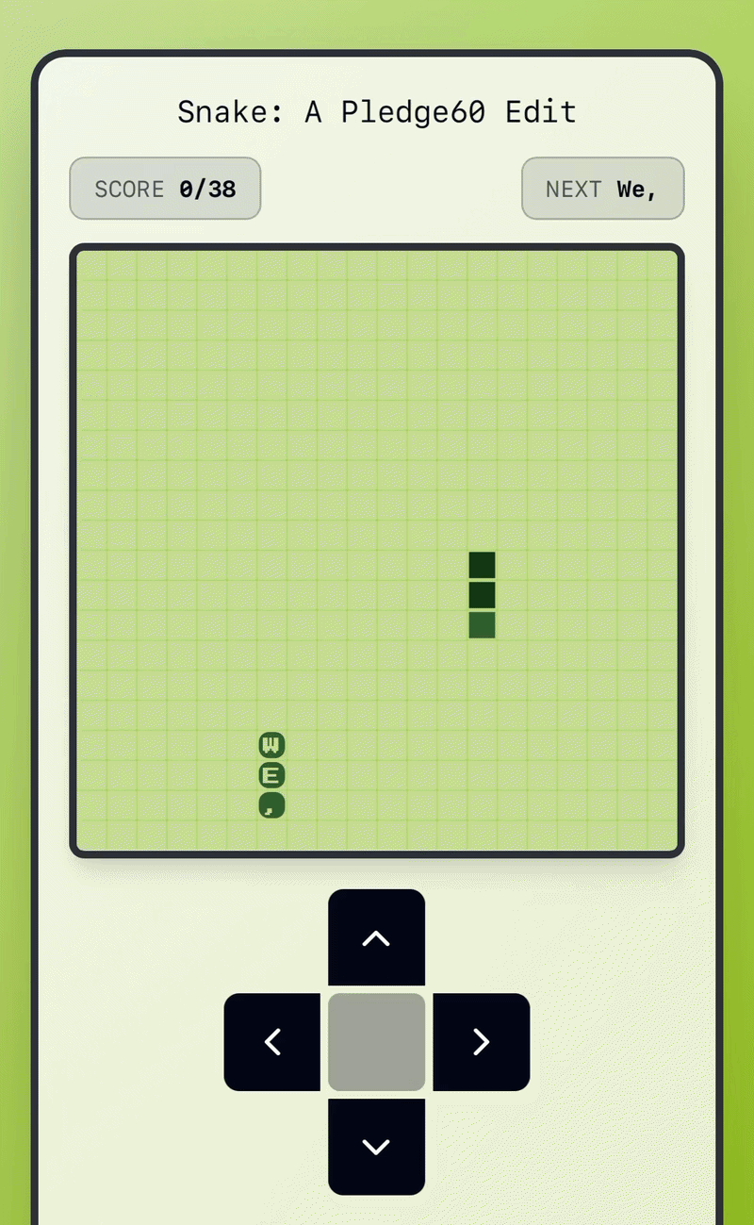

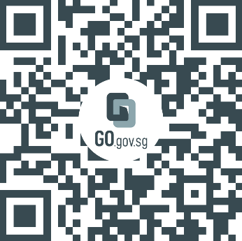

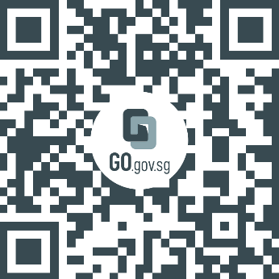


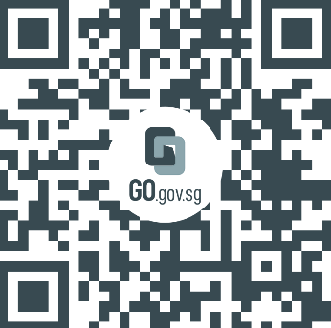
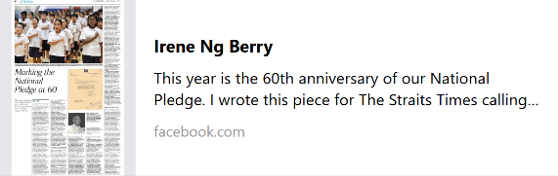
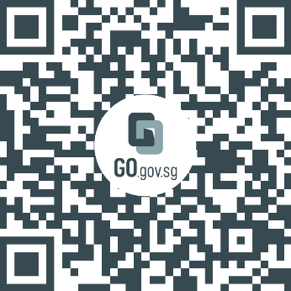
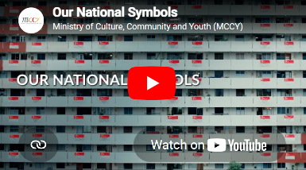
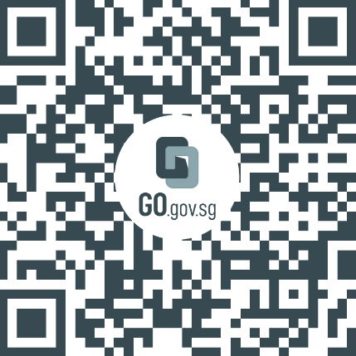
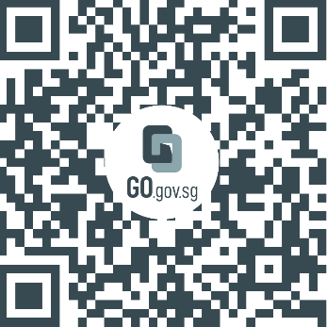

OFFICIAL (OPEN)
Learn more:
1
  NDP2026 album
4
  Play Snake: Pledge edition
2
  Opinion: Marking the National Pledge at 60
5
  Further information on the history of the National Pledge
3
  National Symbols of Singapore
  Your feedback matters.
  Together, we can build better resources. Please take two minutes to share your feedback.
  Follow @connexionsg
  on social media!
9
OFFICIAL (OPEN)
Notes:
Links:
NDP2026 album
YouTube: https://www.youtube.com/user/NDPeeps
Spotify: https://open.spotify.com/artist/1BhtFoW6keQNCZBQEDFmmT?si=jXyEOKg1Q2KNxDD0iPn8FQ
The Straits Times opinion piece by Irene Ng – Marking the National Pledge at 60: https://www.facebook.com/irenengph/posts/this-year-is-the-60th-anniversary-of-our-national-pledge-i-wrote-this-piece-for-/34494414520143676
National Symbols of Singapore: https://go.gov.sg/nationalsymbols
Snake: Pledge Edition: https://pledgesg.lovable.app
The Albatross File: A special showcase on the origins of the National Pledge: https://go.gov.sg/pledge60 (website will be available by 30 Jun 2026 or earlier)
OFFICIAL (OPEN)
OFFICIAL (OPEN)

