Slide 1



Slide 2





About
The ReadSG Challenge is NLB's national reading initiative that invites Singaporeans to rediscover the joy of reading through a simple daily reading habit.
Find Your
Reading Flavour
by completing a simple personality quiz.
Start Reading
at least 15 mins a day to build your reading streak!
Log Your Daily
Reading Sessions
to earn rewards.
Check-in at
Selected Events
to earn bonus coins & receive exclusive goodies!

Slide 3





About
Read for Good (R4G) — previously known as Read For Books — is running from 6 September to 7 October 2026, and we'd love your help to make it a success!
Help us achieve 500,000 sessions (7.5mil reading minutes) to bring reading to a community of up to 10,000 individuals.
Notes:
As part of the ReadSG challenge, Read For Good previously known as Read For Books is running from 7 September to 7 October 2026.

Slide 4



Our Beneficiaries
kidsREAD is a nationwide reading initiative by NLB in partnership with People’s Association, self-help groups, MOE schools and preschools and social service groups to promote the love of reading and cultivate good reading habits among young Singaporeans, specifically children aged 4-8 years old from the less privileged families.
MINDS has been caring for Persons with Intellectual Disability (PWIDs) and their families since 1962. Grounded in the belief that all PWIDs have innate abilities and talents, MINDS is committed to empowering them and enhancing their quality of life, while advocating for greater inclusivity for PWIDs.
Preschool Market is a registered social enterprise committed to assisting underprivileged kids and their families. We believe that every child should have equal access to opportunities in learning and education, and reaching their maximum potential in life regardless of their socio-economical status. They have received the MSF Community Cares award.
Notes:
Beneficiaries

Slide 5

Not sure what to read next? Scan the QR code to find out:
https://go.gov.sg/r4g26-bookrec
go.gov.sg/nlb-childrenandteens
Notes:
Feel free to provide book recommendations if you would like! Otherwise, you can remove this slide.

Slide 6
Let’s Read Together!
Notes:
This marks the beginning of the reading session. Get your participants to pick up their reading materials!

Slide 7

15 Minutes Remaining
Notes:
This section contains an inbuilt timer. Please let the slides run until you see the word “Done”. :)

Slide 8
14 Minutes Remaining
Notes:
This section contains an inbuilt timer. Please let the slides run until you see the word “Done”. :)

Slide 9
13 Minutes Remaining
Notes:
This section contains an inbuilt timer. Please let the slides run until you see the word “Done”. :)

Slide 10
12 Minutes Remaining
Notes:
This section contains an inbuilt timer. Please let the slides run until you see the word “Done”. :)

Slide 11

11 Minutes Remaining
Notes:
This section contains an inbuilt timer. Please let the slides run until you see the word “Done”. :)

Slide 12
10 Minutes Remaining
Notes:
This section contains an inbuilt timer. Please let the slides run until you see the word “Done”. :)

Slide 13
9 Minutes Remaining
Notes:
This section contains an inbuilt timer. Please let the slides run until you see the word “Done”. :)

Slide 14
8 Minutes Remaining
Notes:
This section contains an inbuilt timer. Please let the slides run until you see the word “Done”. :)

Slide 15

7 Minutes Remaining
Notes:
This section contains an inbuilt timer. Please let the slides run until you see the word “Done”. :)

Slide 16
6 Minutes Remaining
Notes:
This section contains an inbuilt timer. Please let the slides run until you see the word “Done”. :)

Slide 17
5 Minutes Remaining
Notes:
This section contains an inbuilt timer. Please let the slides run until you see the word “Done”. :)

Slide 18
4 Minutes Remaining
Notes:
This section contains an inbuilt timer. Please let the slides run until you see the word “Done”. :)

Slide 19

3 Minutes Remaining
Notes:
This section contains an inbuilt timer. Please let the slides run until you see the word “Done”. :)

Slide 20
2 Minutes Remaining
Notes:
This section contains an inbuilt timer. Please let the slides run until you see the word “Done”. :)

Slide 21
1 Minute Remaining
Notes:
This section contains an inbuilt timer. Please let the slides run until you see the word “Done”. :)

Slide 22
Well Done!
Smile For The Camera!

Slide 23
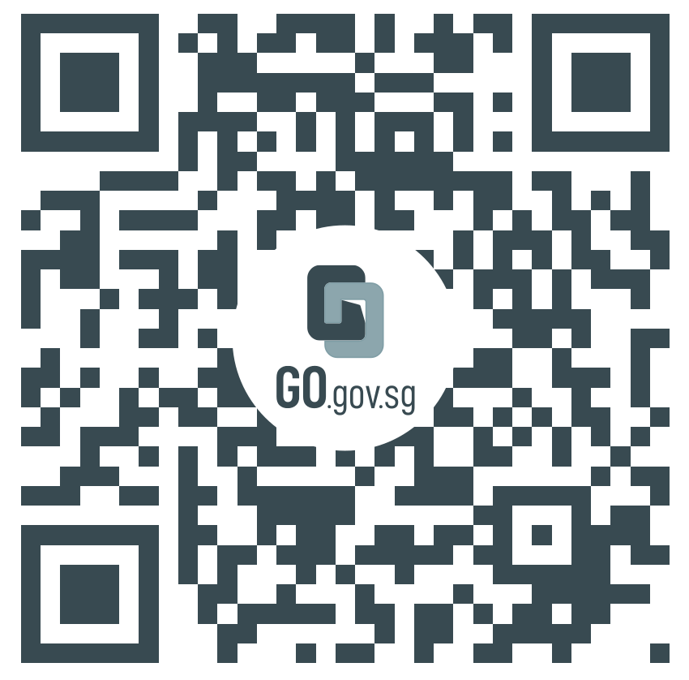
Thank you for participating in
Please share your thoughts on Read For Good with NLB by scanning this QR code:
https://go.gov.sg/r4g26-feedback
Notes:
If possible, please ask your participants to help us complete a quick form to help NLB improve our programmes. Thank you very much!

Slide 24





Join the ReadSG Challenge:
The ReadSG challenge is hosted on Crowdtask and will require a SIngpass account to sign up.
https://go.gov.sg/rcct
Join R4G as an organisation, family, group,
or individual:
No Singpass account required.
https://go.gov.sg/r4g26-all
Notes:
The reading doesn’t have to stop here, join the ReadSG challenge and discover the power of 15 minutes. Read More, Be More
https://go.gov.sg/rcct

