Slide 1
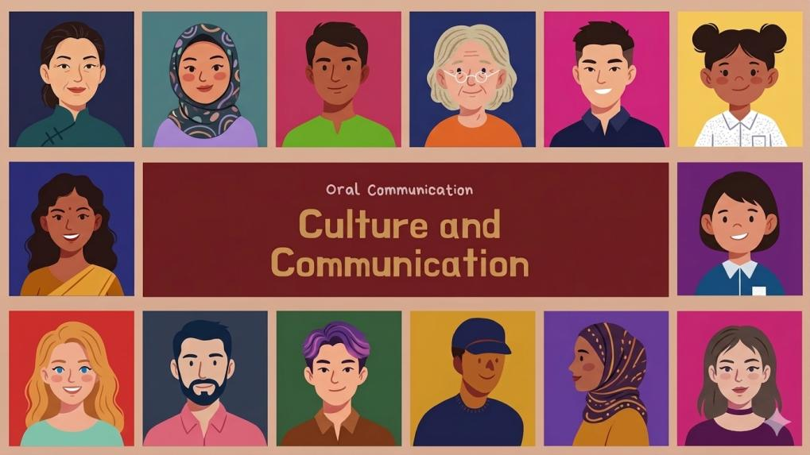



OFFICIAL (OPEN)
Racial Harmony Day 2026
From one generation to the next:
A uniquely multicultural Singapore
NE Engagement Package
Racial Harmony Day 2026 Engagement Package
OFFICIAL (OPEN)
Notes:
OFFICIAL (OPEN)
OFFICIAL (OPEN)

Slide 2


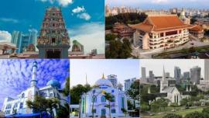
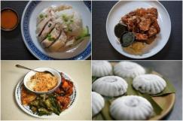


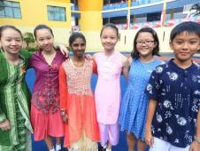
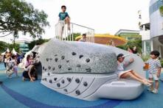
OFFICIAL (OPEN)
Harmony in Action
What makes Singapore feel like Singapore?
Multiculturalism in Singapore is deeply woven into everyday life. Regardless of race, language, or religion, Singaporeans live, work, and celebrate together every day.
OFFICIAL (OPEN)
Notes:
Talking Points:
<Facilitator to highlight points in the slide.>
We often take Singapore's social cohesion for granted. It's not always a given that people of different races, religions, and backgrounds can live together in harmony.
OFFICIAL (OPEN)
OFFICIAL (OPEN)

Slide 3








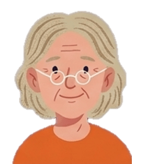

OFFICIAL (OPEN)
This harmony did not happen by chance. It was built patiently over generations through mutual respect, trust, and understanding. Our harmony must be actively renewed, and not taken for granted. Each generation has a responsibility to strengthen it – through how we live, interact, and treat one another.
- Prime Minister Lawrence Wong, in his 2026 Chinese New Year Message on 16 Feb 2026
OFFICIAL (OPEN)
Notes:
Talking Points:
As PM Wong notes, Singapore’s harmony did not happen by chance. It is the result of deliberate choices made over generations to trust, respect, and understand our fellow Singaporeans no matter what their race, religion, or background are.
OFFICIAL (OPEN)
OFFICIAL (OPEN)

Slide 4
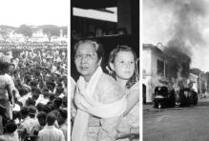
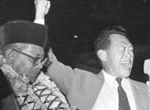
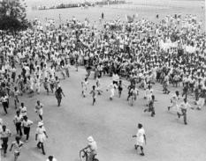
OFFICIAL (OPEN)
1950 Maria Hertogh Riots
Triggered by a custody dispute involving a Dutch girl raised by a Muslim family, the riots escalated amid emotional media coverage and religious sensitivities. The unrest, which left 18 dead and 173 injured, revealed how quickly rumours, misinformation, and communal tensions could spiral into violence.
Singapore’s harmony was built gradually over generations
Image: The Straits Times
Singapore’s early years revealed a hard truth: in a young and fragile nation, race and religion were fault lines that posed a real threat to our survival.
The Maria Hertogh riots in 1950 and 1964 racial riots showed how quickly trust among communities could break down, and how difficult it was to rebuild that trust, once lost.
Against the backdrop of Singapore’s independence in 1965, our leaders faced a defining challenge: How to prevent divisions from taking root in a diverse society, and build a cohesive nation?
Separation Tensions
In the years leading up to Singapore’s separation from Malaysia in 1965, communal politics and racial tensions created deep uncertainty about the future. Documents referenced in The Albatross File book and exhibition highlight concerns that worsening divisions could destabilise the young nation and threaten its survival.
Image: The Straits Times
1964 Racial Riots
Violence broke out between Chinese and Malay communities in July and September 1964 during a period of heightened political and communal tensions in Singapore and Malaysia. The riots resulted in 36 deaths and over 500 injuries.
Image: National Archives of Singapore
OFFICIAL (OPEN)
Notes:
Talking Points:
Let’s look back at a time when racial tensions had very real consequences for Singapore. <Facilitator to highlight points in the slide>
[For facilitator's information]
The Albatross File
To mark Singapore’s 60 years of independence, a permanent exhibition, "The Albatross File: Singapore’s Independence Declassified", invites visitors to an introspective experience of the nation’s defining moments, from merger to separation.
The exhibition, which is located at the National Library Building, is based on the book, "The Albatross File: Inside Separation".
Visitors to the exhibition can view original artefacts on display for the first time, including declassified extracts of oral histories from Singapore’s founding Prime Minister Mr Lee Kuan Yew and former Deputy Prime Minister Dr Goh Keng Swee.
OFFICIAL (OPEN)
OFFICIAL (OPEN)

Slide 5
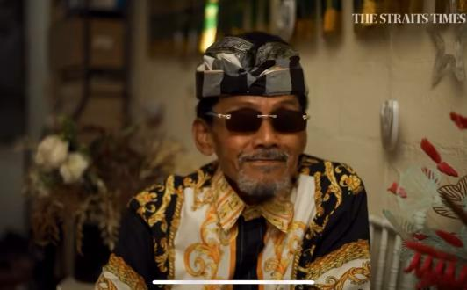


OFFICIAL (OPEN)
Memories of 1964
A reflection by Mr Mohamad Sharif who lived through the 1964 riots
Experiences like these shaped how Singapore thought about building everyday trust among communities.
I feel really grateful that (the founding leaders) wanted to have a multiracial country. Work together, talking together, and eat together.
Video: The Straits Times
OFFICIAL (OPEN)
Notes:
Talking Points:
For many Singaporeans today, these events feel distant. This reflection offers a glimpse into what life was like during the period of racial unrest and helps us better understand why racial harmony remains so important.
<Facilitator to play video>
OFFICIAL (OPEN)
OFFICIAL (OPEN)

Slide 6

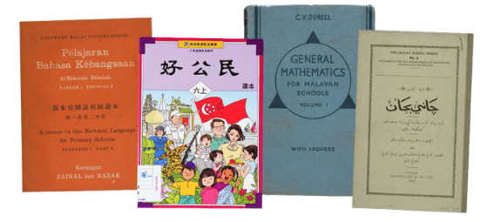
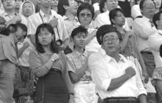
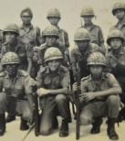
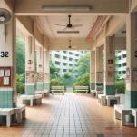

OFFICIAL (OPEN)
Early educational materials reflected Singapore’s bilingual education and cultural heritage.
This enabled us to engage fellow Singaporeans of different races and access the global economy, while remaining connected to our cultural roots.
Designing for Cohesion
Image: National Library Singapore and Collection of
National Museum of Singapore
Singapore’s early leaders intentionally created opportunities for different communities to live and learn together, and interact. Over generations, these shared experiences fostered mutual understanding and a shared identity that continue to shape Singapore’s multicultural society today.
Reciting the National Pledge is a shared ritual that reinforces unity and mutual respect.
Image: National Archives of Singapore
National Service, a shared rite of passage that transcends race, language, and religion for generations of Singaporeans, was introduced in 1967.
Reflect: What shared experiences or common spaces make you feel most connected to other Singaporeans? Why?
Image: National Archives of Singapore
Shared neighbourhood spaces bring people together and strengthen social bonds.
Image: Deck-ed Out
OFFICIAL (OPEN)
Notes:
Talking Points:
The lessons from that period shaped how Singapore approached nation-building, with a focus on creating opportunities for different backgrounds to live and learn together, and interact.
<Facilitator to highlight reflection question and examples in the right column.>
OFFICIAL (OPEN)
OFFICIAL (OPEN)

Slide 7


OFFICIAL (OPEN)
Hidden Racial Biases Remain
While most people (71.1%) say they do not let a person’s race influence their social interactions, racial stereotyping has increased. In 2024, 43.5% of respondents admit to making assumptions about a person's behaviour based on race, up from 35.2% in 2018.
The increase in stereotyping suggests that underlying biases remain present despite improvements in social cohesion.
Source: 2024 IPS-OnePeople.sg survey
7
OFFICIAL (OPEN)
Notes:
Talking Points:
While progress has been made, biases and stereotypes have not disappeared entirely.
<Facilitator to highlight points in the slide.>
OFFICIAL (OPEN)
OFFICIAL (OPEN)

Slide 8


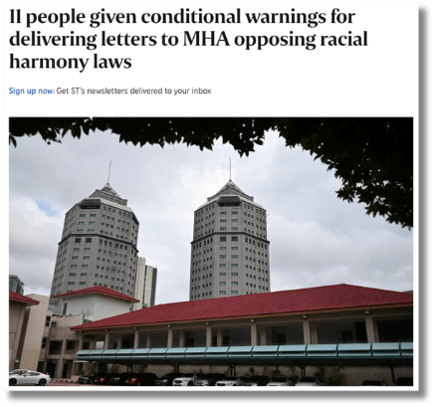
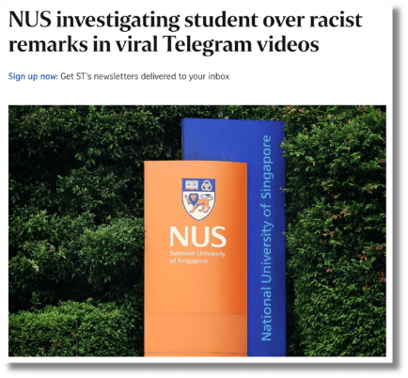
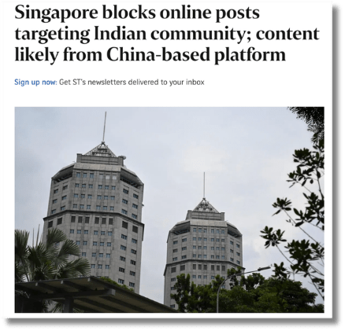
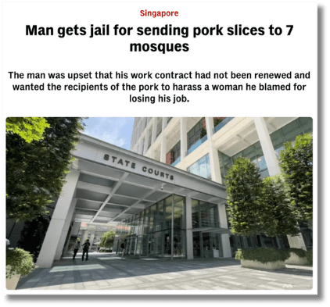
OFFICIAL (OPEN)
Fault Lines Still Exist Today
Fault lines today may not look the same as those of the past, but they have not disappeared. Recent incidents remind us that differences in race, religion, and beliefs can still create tensions, underscoring the need for continued efforts to strengthen social cohesion.
The Straits Times, 25 Mar 2026
The Straits Times, 24 Apr 2026
Channel NewsAsia, 11 May 2026
The Straits Times, 9 Jun 2026
OFFICIAL (OPEN)
Notes:
Talking Points:
These underlying biases still surface today, as seen from recent incidents.
<Facilitator to highlight examples in the slide.>
OFFICIAL (OPEN)
OFFICIAL (OPEN)

Slide 9

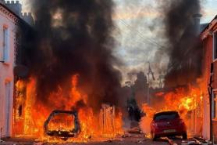

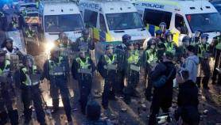
OFFICIAL (OPEN)
Social Media: A New Fuel for Tensions
Today, these tensions are often amplified through online platforms, where information spreads faster and reaches a wider audience than ever before.
Recent incidents in Belfast and Southampton show how quickly issues involving race and identity can escalate when amplified online.
Vehicles burning from riots in Belfast on 9 Jun 2026
Image: Wall Street Journal
Why does this matter for Singapore?
Social cohesion cannot be taken for granted. We all have a role in verifying information, engaging one another respectfully, and resisting divisive narratives.
Police at the Southampton protest on 2 Jun 2026
Image: BBC
OFFICIAL (OPEN)
Notes:
Talking Points:
In today’s connected world, such incidents are no longer contained. They are quickly picked up, shared, and interpreted across communities online.
<Facilitator to highlight recent incidents in Belfast and Southampton escalating as a result of online amplification and draw the link to why it matters for Singapore.>
[For facilitator’s information]
Belfast riots (9 Jun 2026)
On 9 Jun 2026, widespread anti-immigrant riots erupted across Belfast following a viral video of a violent knife attack involving a Sudanese man who was charged with attempted murder.
Masked groups engaged in coordinated attacks, setting vehicles and properties on fire and specifically targeting the homes of immigrant families, including those from Romanian, Sudanese, and Ukrainian backgrounds.
The unrest, which was fuelled by far-right agitation online, saw mobs going door-to-door in several neighbourhoods to identify and intimidate residents based on their race or perceived migrant status.
The violence caused significant destruction, left dozens of people homeless, and forced local authorities to deploy armoured police vehicles to manage the disorder.
Southampton riots (2 Jun 2026)
In 2025, Henry Nowak, an 18-year-old white man, was handcuffed by the police as he lay dying from stab wounds after his killer falsely alleged a racial attack. The killer, a Sikh man, was sentenced on 1 Jun 2026 to life in prison.
On 2 Jun 2026, clashes broke out between protesters and police in Southampton after the release of bodycam footage linked to the fatal stabbing. The footage showed officers ignoring Nowak’s pleas as he lay dying, sparking questions over why the police had believed the allegation of racism and not Nowak, who said repeatedly that he had been stabbed and could not breathe.
The bodycam footage went viral on X and TikTok, where far-right activists amplified it to organise protests and spread anti-immigrant and anti-police misinformation.
OFFICIAL (OPEN)
OFFICIAL (OPEN)

Slide 10

OFFICIAL (OPEN)
Think About It...
1. Why do you think incidents involving race and religion continue to occur despite generations of living together in a multicultural society?
2. What actions can we take within our communities to enhance racial and religious harmony?
3. How can we use social media to strengthen, rather than strain, social cohesion?
OFFICIAL (OPEN)
Notes:
Talking Points:
<Facilitator to go through above reflection questions and encourage sharing.>
OFFICIAL (OPEN)
OFFICIAL (OPEN)

Slide 11

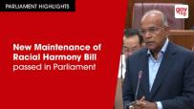




OFFICIAL (OPEN)
National Initiatives
By MCCY
Others
Harmony Circles
Maintenance of Racial Harmony Act
Passed in 2025, the Maintenance of Racial Harmony Act enables action against harmful racial content, safeguards race-based organisations from foreign influence, and promotes reconciliation through community remedial initiatives.
Drive interfaith dialogue, cultural exchange, and joint community initiatives.
Harmony Fund
OnePeople.sg
Fosters social cohesion through intergroup dialogues, school outreach programmes, community events, and programmes that promote cross-cultural understanding and trust.
Supports ground-up initiatives that promote racial and religious harmony.
OFFICIAL (OPEN)
Notes:
Talking Points:
Singapore has put in place strong national-level safeguards and frameworks to strengthen trust and protect social cohesion.
<Facilitator to highlight points in the slide.>
OFFICIAL (OPEN)
OFFICIAL (OPEN)

Slide 12





OFFICIAL (OPEN)
Community Initiatives
A vibrant array of activities and programmes that aim to build a deeper appreciation for Singapore’s diversity awaits.
We all have a role to play to build a harmonious society by:
  Understanding one another
  Appreciating our differences and commonalities
  Building trust and respect among different groups
www.harmonycircle.sg
Take part in events during
Racial and Religious Harmony Month!
OFFICIAL (OPEN)
Notes:
Talking Points:
Beyond national initiatives, what happens at the community level is important as we all have a role to play in building a harmonious society.
<Facilitator to highlight points in the slide.>
OFFICIAL (OPEN)
OFFICIAL (OPEN)

Slide 13



OFFICIAL (OPEN)
Individual Initiatives
We can each play our part to preserve and safeguard racial and religious harmony, and social cohesion in Singapore.
Practise good neighbourliness
Build meaningful relationships across communities
Practise responsible online behaviour
Show care and graciousness for one another.
Personal relationships help break down stereotypes and foster mutual understanding.
Engage in online discussions respectfully, even when our opinions differ.
OFFICIAL (OPEN)
Notes:
Talking Points:
Ultimately, we strengthen mutual trust and understanding when we play our part in our everyday interactions.
<Facilitator to highlight examples in the slide.>
OFFICIAL (OPEN)
OFFICIAL (OPEN)

Slide 14
OFFICIAL (OPEN)
We must continue to nurture what makes us distinctively Singaporean: the ability to accept our varied identities, to take a respectful interest in each other's cultures, and to build common ground through shared experiences.
- President Tharman Shanmugaratnam in his inaugural President's Address during the opening of the First Session of the 15th Parliament, 5 Sep 2025
OFFICIAL (OPEN)
Notes:
Talking Points:
As we look ahead, sustaining the harmony we have today remains a shared responsibility. As President Tharman puts it, we need to continue putting in effort to nurture what makes us distinctly Singaporean.
OFFICIAL (OPEN)
OFFICIAL (OPEN)

Slide 15



OFFICIAL (OPEN)
Useful Resources
SG101
OnePeople.sg
MCCY
<Check with MCCY if they have any open-source resources>
www.sg101.gov.sg
www.onepeople.sg/pages/cultural-and-religious-sources
www.harmonycircle.sg/
For content and resources about Singapore’s journey as a nation.
For content and resources about culture and religion.
Take part in events during Racial and Religious Harmony Month.
OFFICIAL (OPEN)
Notes:
OFFICIAL (OPEN)
OFFICIAL (OPEN)

Slide 16










OFFICIAL (OPEN)
Thank you!
Your feedback is valuable to us.
Follow us online for more
National Education content:
Please take a minute to share your feedback through the
following link or QR code:
go.gov.sg/feedback-rh2026
https://go.gov.sg/sg101
OFFICIAL (OPEN)
Notes:
OFFICIAL (OPEN)
OFFICIAL (OPEN)

