Slide 1


Slide 2
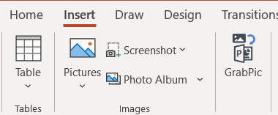


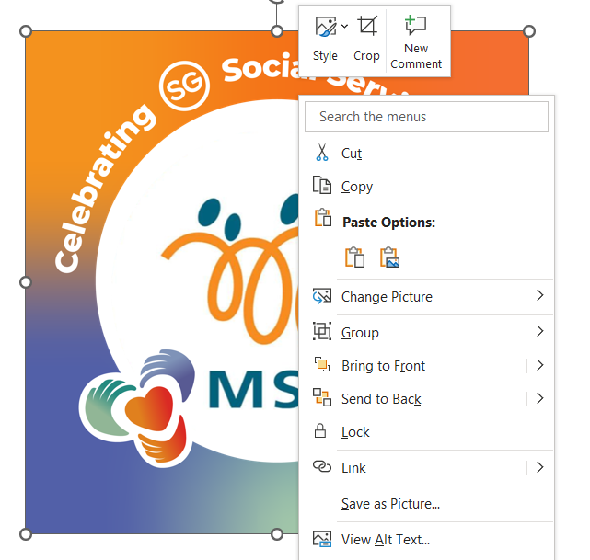
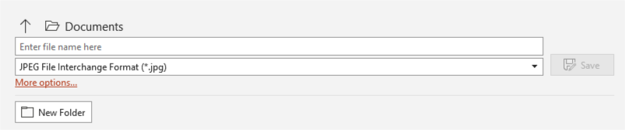
Steps to add YCPartners Frame to your profile image on desktop
Using this template, add your profile image by clicking on the menu bar “Insert Picture from This Device”
2. Select the image of your choice from your file and click “Insert”
3. Adjust the size of the image to fit within the frame
4. Right click on your picture & click on “Send to Back”
5. Your picture should be within the frame
6.To save the image, click on “File”, “Save As” and ensure that the file format to “JPEG File Interchange Format (*.jpg)”, click on “Save” and “Just This One” to save a Jpeg version of your image to your selected folder.

